Slide 1
Internal Working of ConcurrentHashMap
By Saranya Kesavan

Slide 2
Package : java.util.concurrent.ConcurrentHashMap
Introduced in : jdk1.5
Implements : Map interface
Concurrency Level : Tells how many threads can access ConcurrentHashMap concurrently, default concurrency level of ConcurrentHashMap is 16.
Initial Capacity : Initial capacity is 200, it means CHM make sure it has space for adding 200 key-value pairs after creation.
Load Factor : 0.75 by default.
Threshold = initial capacity * load factor
= 200 * 0.75 = 150

Slide 3
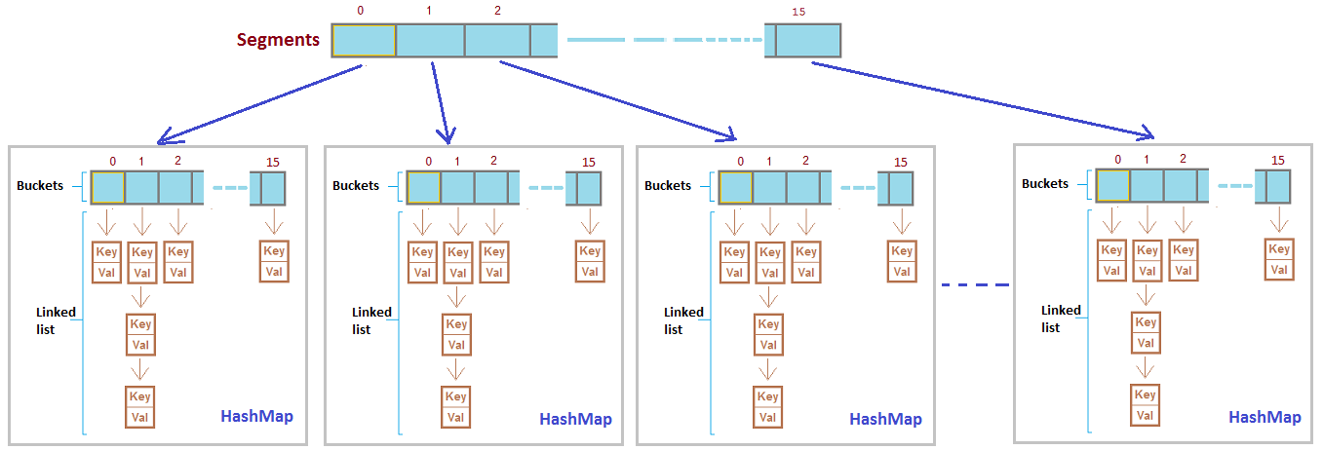
Architecture of ConcurrentHashMap

Slide 4
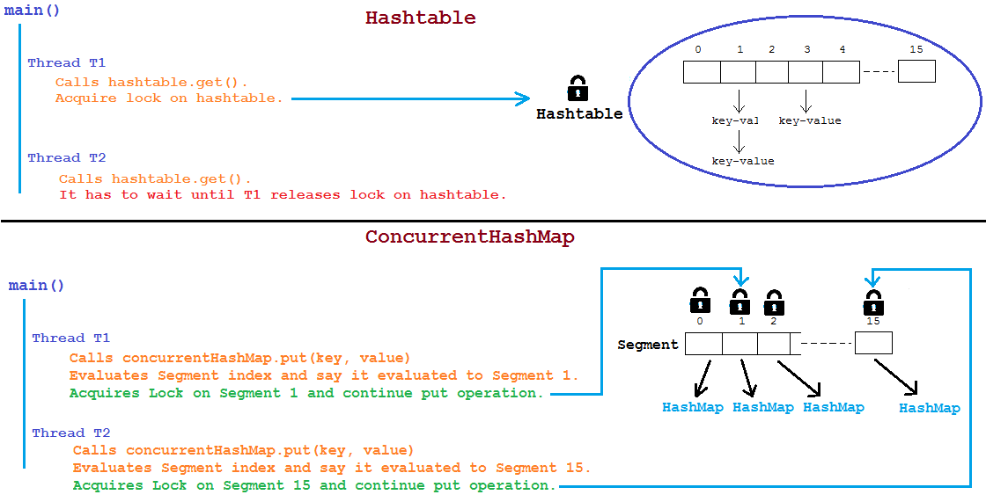
Why ConcurrentHashMap?

Slide 5
Rehashing
Every segment is separately rehashed
No collision between Threads.
Eg: Thread 1 writing to Segment index 1 and Thread 2 writing to Segment index 4.

Slide 6
Points to Remember
Segment array size
-higher → waste of space and time
-smaller → leads to thread competition
2. Consider two threads T1 and T2.
 | Read | Write | Read-Write
Same Segment | yes | No | yes
Different Segment | yes | yes | yes

Slide 7
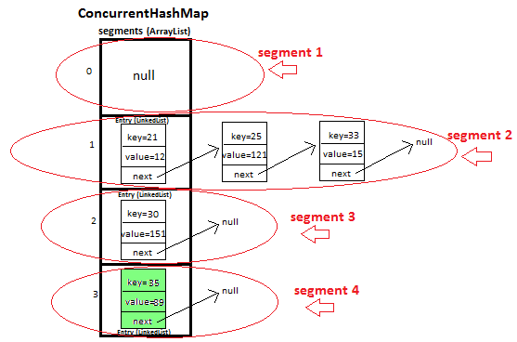
Example:

Slide 8
1. What will happen map.put(25,12) is called and some other thread concurrently calls map.get(25)?
Answer : When map.put(25,12) is called segment 2 will be locked,
key=25 also lies in segment 2, When thread locks one segment for updation it does not block it for retrieval hence some other thread can read the same segment, but it will be able to read the data before locking (hence map.get(25) will return 121)
2. What will happen map.put(25,12) is called and some other thread concurrently calls map.get(33)?
Answer : When map.put(25,12) is called segment 2 will be locked,
key=33 also lies in segment 2, When thread locks one segment for updation it does not block it for retrieval hence some other thread can read the same segment, but it will be able to read the data before locking (hence map.get(33) will return 15)
3. What will happen map.put(25,12) is called and some other thread concurrently calls map.put(33,24)?
Answer : When map.put(25,12) is called segment 2 will be locked,
key=33 also lies in segment 2, When thread locks one segment for updation it does not allow any other thread to perform updations in same segment until lock is not released on segment.
hence map.put(33,24) will have to wait for map.put(25,12) operation to release lock on segment.

Slide 9
4. What will happen map.put(25,12) is called and some other thread concurrently calls map.put(30,29)?
Answer : When map.put(25,12) is called segment 2 will be locked,
but key=30 lies in segment 3.
Both the keys lies in different segments, hence both operations can be performed concurrently.
5. What will happen updations (put/remove) are in process in certain segments and new key-pair have to be put/remove in same segment ?
Answer : When updations are in process thread locks the segment and it does not allow any other thread to perform updations (put/remove) in same segment until lock is not released on segment.

